Slide 1




LARNet: Lie Algebra Residual Network for Face Recognition
Xiaolong Yang, Xiaohong Jia, Dihong Gong, Dong-Ming Yan, Zhifeng Li, Wei Liu
AMSS,CAS
UCAS
Tencent Data Platform
CASIA

Slide 2
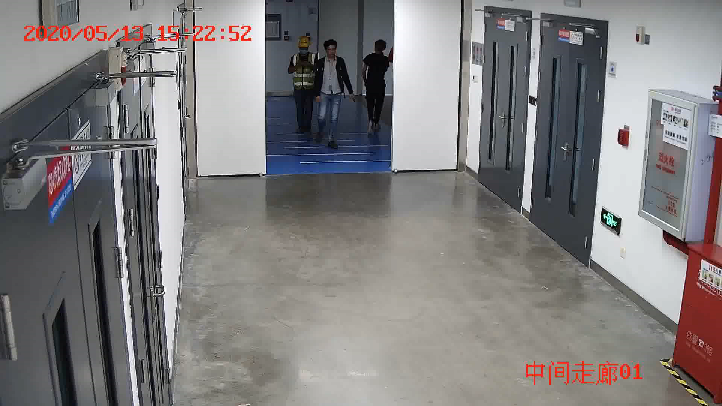
Introduction
A major challenge in practical face recognition applications lies in significant variations between profile and frontal faces.
NOT EASY for face recognition
with large pose or profile faces !
2

Slide 3
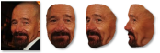

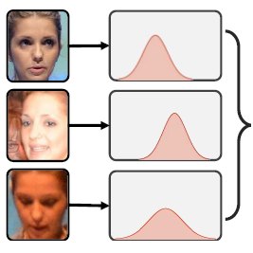
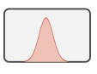
Introduction
Traditional techniques:
Masi et al. (2016)
Enrich sources by the synthesis of profile faces
Unnecessary computational burdens
Rotate-and-Render (2020)
Frontalize faces under all pose ranges
Occlusions and non-rigid expressions
Probabilistic Face Embeddings (2019)
Represent face images as a Gaussian distribution
Overly strong hypothesis prior
3

Slide 4
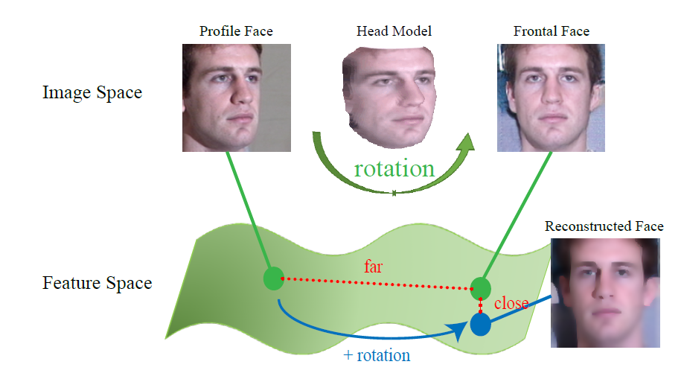
Our method
We explore how face rotation in the 3D space affects the deep feature generation process.
The difference between frontal and profile face images
→ Head rotation in 3D space
Face recognition for images
→ Clustering in the deep feature space
4

Slide 5
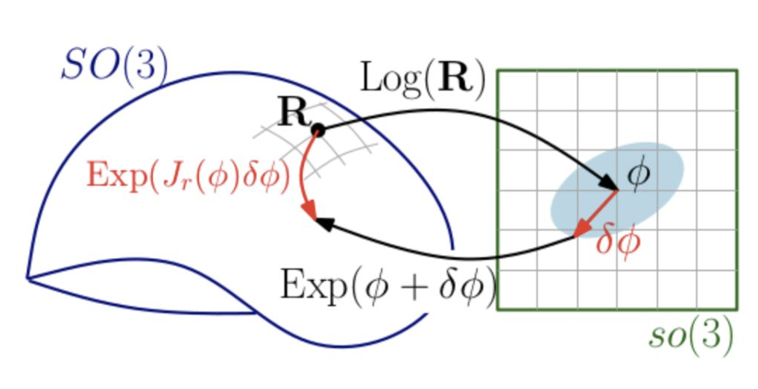


Our method
Rotation matrices are not easy to be embedded in CNNs.
Rotation group is not completely closed.
$∀R_{1} ,R_{2}∈SO\left(3\right), R_{1}⋅R_{2}∈SO\left(3\right)$ ✔
$∀R_{1} ,R_{2}∈SO\left(3\right), R_{1}+R_{2}∈SO\left(3\right)$ ❌
New tools – Lie group and Lie algebra
closed under addition and multiplication operations → Lie group
derivable → smooth and continuous → Lie group (differential manifold)
derivative operation → tangent space of Lie group → Lie algebra
non-linear optimization → Lie algebra attached to the vector space
5

Slide 6
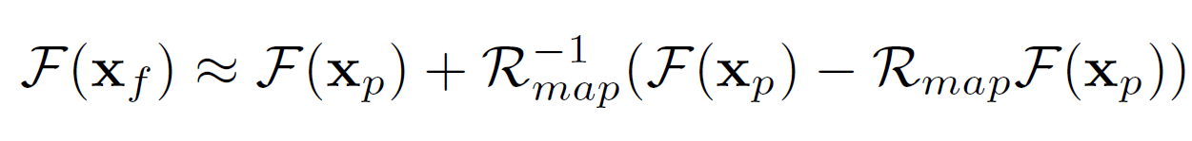
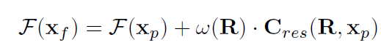
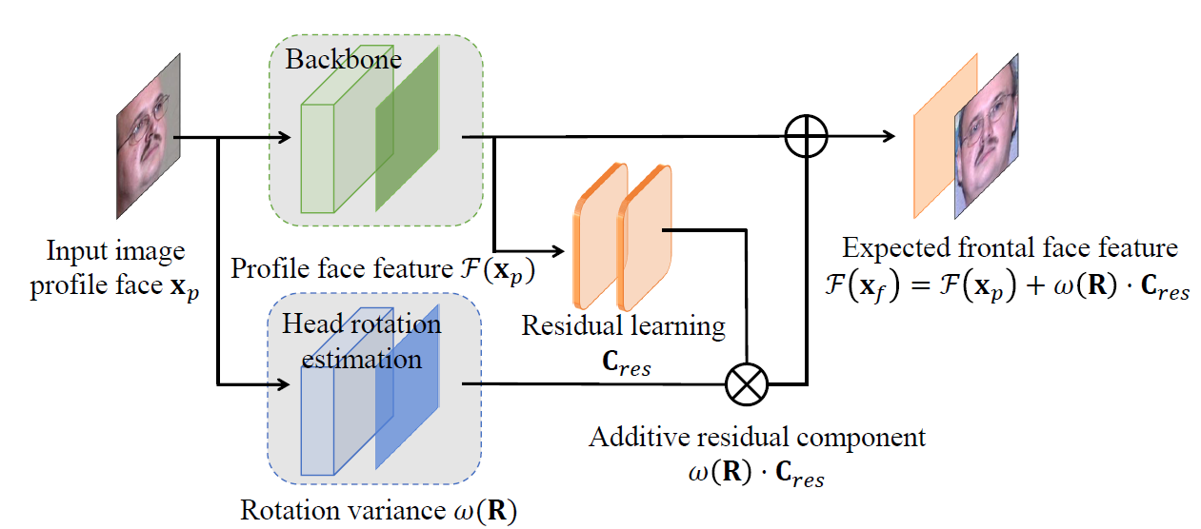
Our method
The frontal-profile face feature pairs in ResNet based on the Lie algebra theory:
$C_{res}$ : a residual subnet for decoding rotation information from input face images
$ω(R)$: a gating subnet to learn rotation magnitude for controlling the strength of $C_{res}$
Our succinct architecture:
6

Slide 7
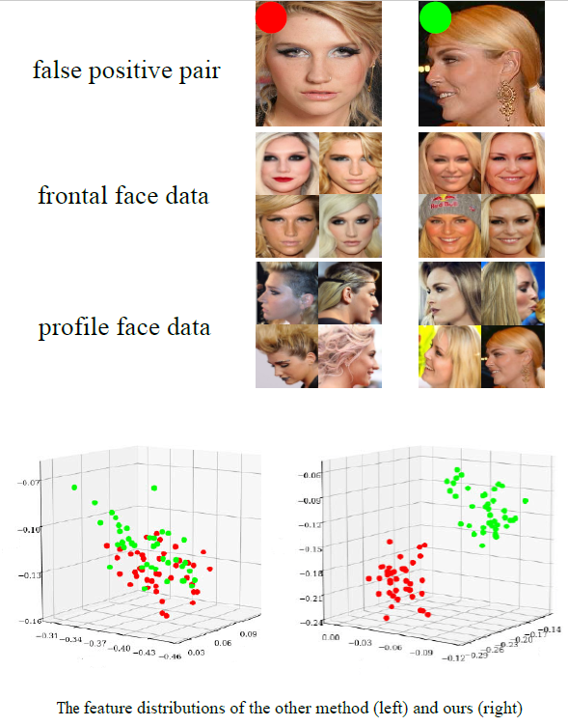
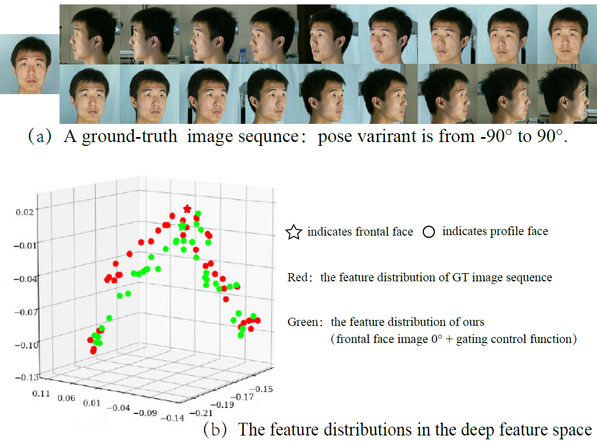
Visualization results – feature distributions
Feature Representation
different-pose samples with the same identity
Feature Clustering
different-pose samples with the different identities
7

Slide 8
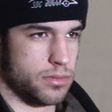
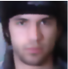
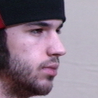
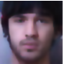
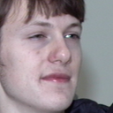
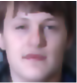
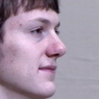
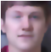
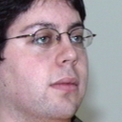
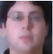
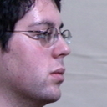
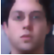
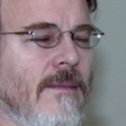

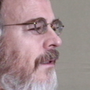

Visualization results – reconstructed faces
15°profile faces
45°profile faces
60°profile faces
8

Slide 9
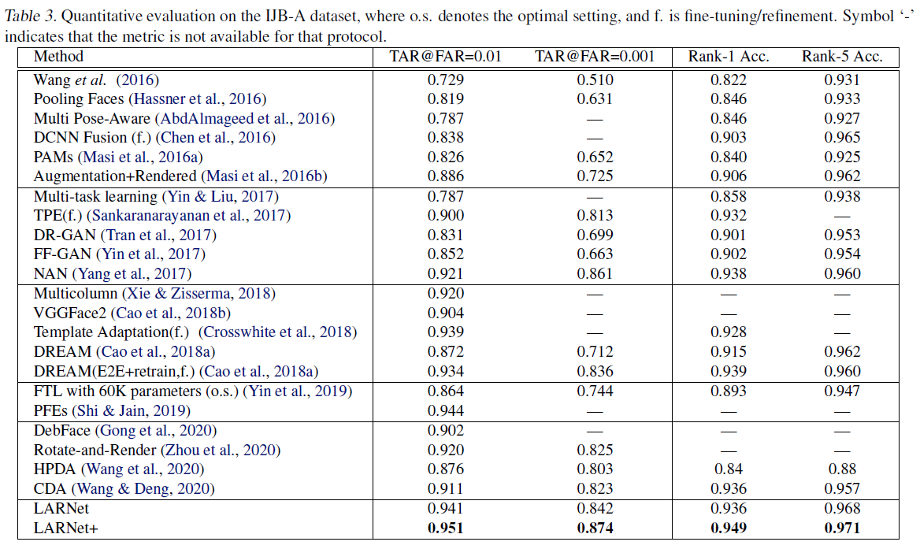
Quantitative evaluation
Quantitative evaluation on IJB-A dataset
Our results surpass many competitors in the
recent 5 years under all 4 evaluation criteria:
Verification task
achieve 95%+ under TAR@FAR=0.01
& 87%+ under TAR@FAR=0.001
Identification task
achieve 95% under Rank-1 recognition accuracy
& 97%+ under Rank-5 recognition accuracy
9

Slide 10
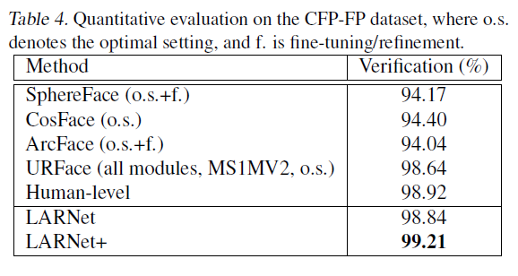
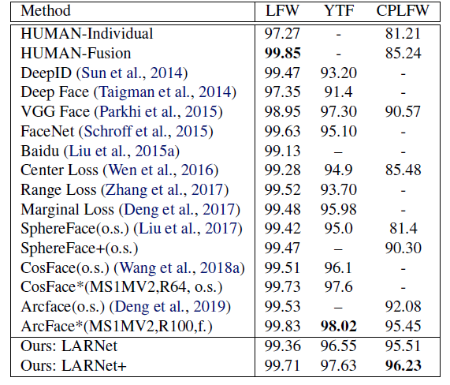
Quantitative evaluation
Quantitative evaluation on CFP-FP dataset
Quantitative evaluation on LFW,YTF, and CPLFW datasets
The first result achieves 99%+ on CFP-FP dataset.
The first result surpasses the reported human-level.
Our method also outperforms on general face recognition datasets.
10

Slide 11



THANKS
LARNet: Lie Algebra Residual Network for Face Recognition
yangxiaolong17@mails.ucas.ac.cn
Paper Homepage
QR Code
paradocx.github.io

